Slide 1
Correlation
Regression
Covariance

Slide 2
Covariance and correlation describe how two variables are related.
Variables are positively related if they move in the same direction.
Variables are inversely related if they move in opposite directions.
Both covariance and correlation indicate whether variables are positively or inversely related.
Correlation also tells you the degree to which the variables tend to move together.

Slide 3
Covariance
Covariance indicates how two variables are related.
A positive covariance means the variables are positively related, while a negative covariance means the variables are inversely related. The formula for calculating covariance of sample data is shown below.
x = the independent variable y = the dependent variable n = number of data points in the sample = the mean of the independent variable x = the mean of the dependent variable y

Slide 4
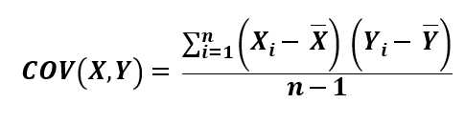


Slide 5
covariance measures variables that have different units of measurement.
Using covariance, you could determine whether units were increasing or decreasing, but it was impossible to measure the degree to which the variables moved together because covariance does not use one standard unit of measurement.
To measure the degree to which variables move together, you must use correlation.

Slide 6
The correlation measurement, called a correlation coefficient, will always take on a value between
1 and – 1

Slide 7
If the correlation coefficient is one, the variables have a perfect positive correlation. This means that if one variable moves a given amount, the second moves proportionally in the same direction. A positive correlation coefficient less than one indicates a less than perfect positive correlation, with the strength of the correlation growing as the number approaches one.
If correlation coefficient is zero, no relationship exists between the variables. If one variable moves, you can make no predictions about the movement of the other variable; they are uncorrelated.
If correlation coefficient is –1, the variables are perfectly negatively correlated (or inversely correlated) and move in opposition to each other. If one variable increases, the other variable decreases proportionally. A negative correlation coefficient greater than –1 indicates a less than perfect negative correlation, with the strength of the correlation growing as the number approaches –1.

Slide 8
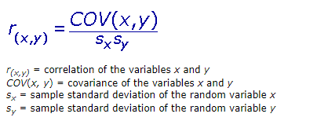
To calculate the correlation coefficient for two variables, you would use the correlation formula, shown below.

Slide 9
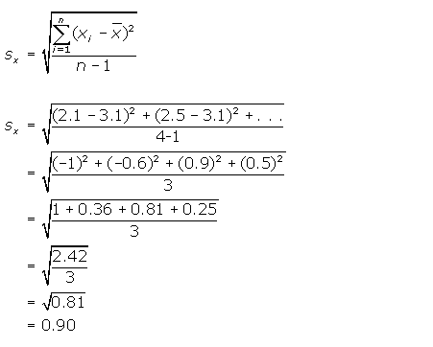

Slide 10
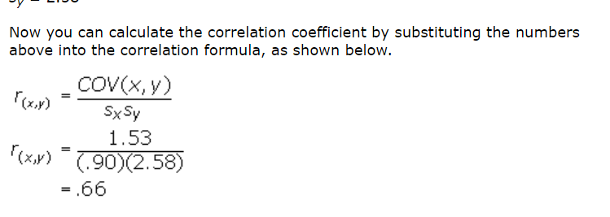

Slide 11
http://ci.columbia.edu/ci/premba_test/c0331/s7/s7_5.html

Slide 12
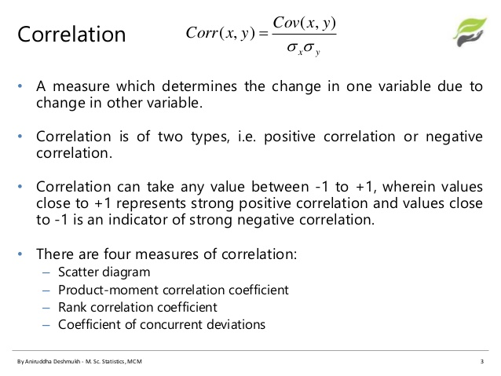

Slide 13
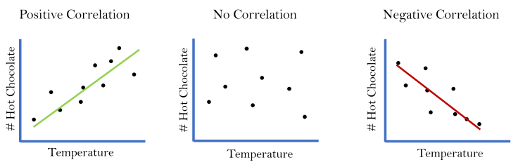

Slide 14
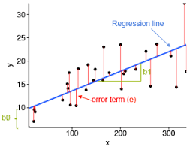

Slide 15
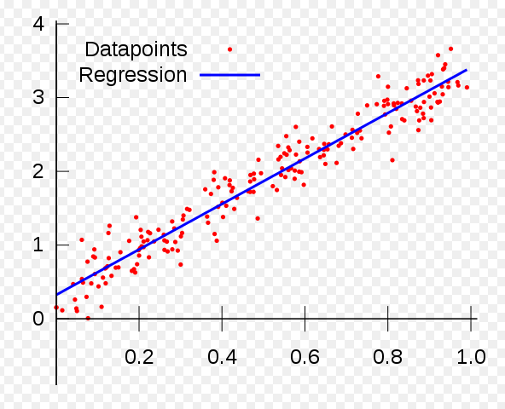

Slide 16
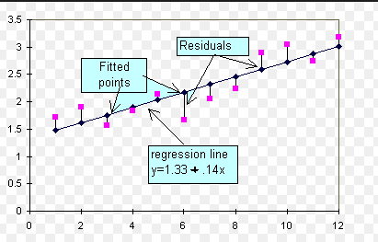

Slide 17
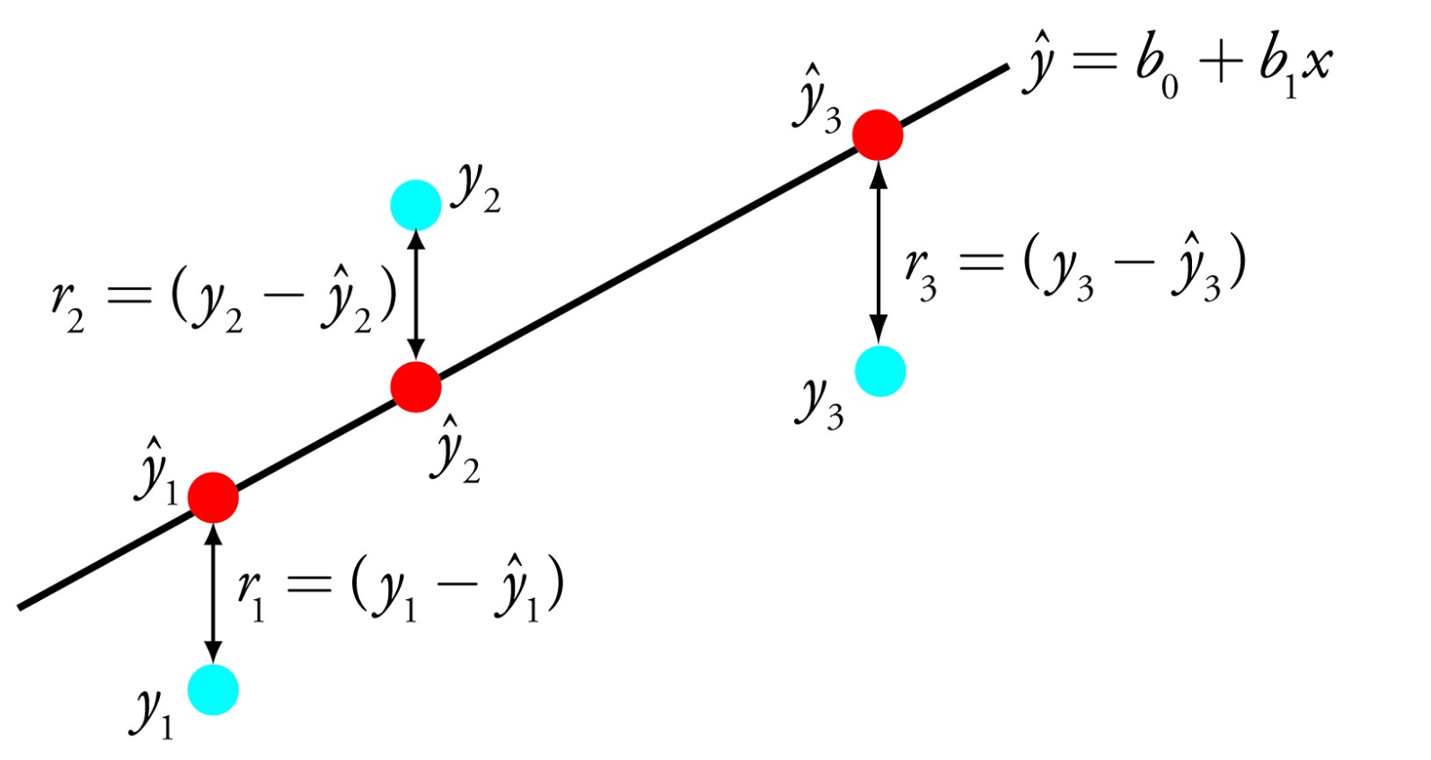

Slide 18
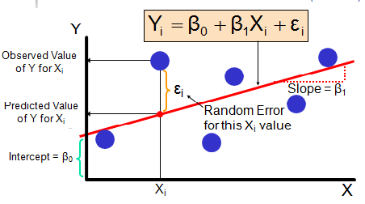

Slide 19
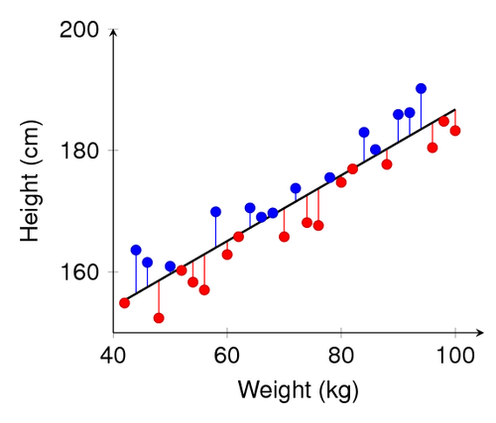

Slide 20
Linear
Logistic

Slide 21
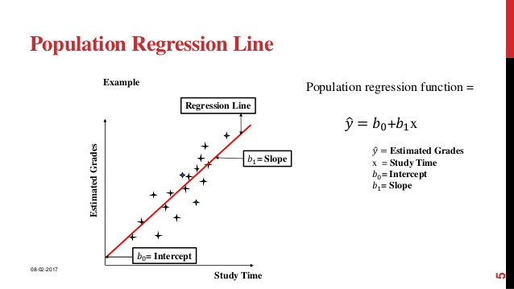

Slide 22


Slide 23
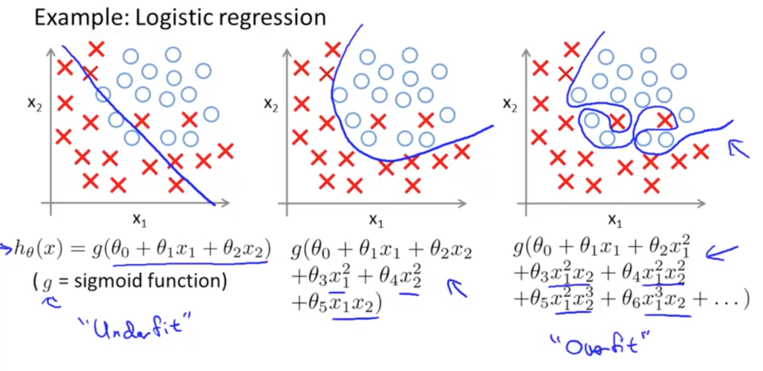

Slide 24
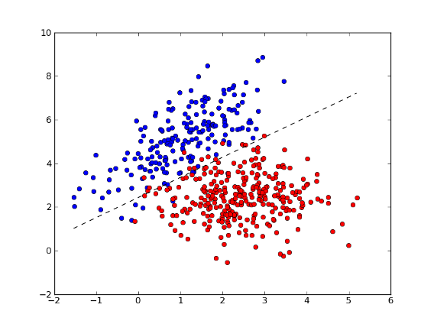
Logistic

Slide 25
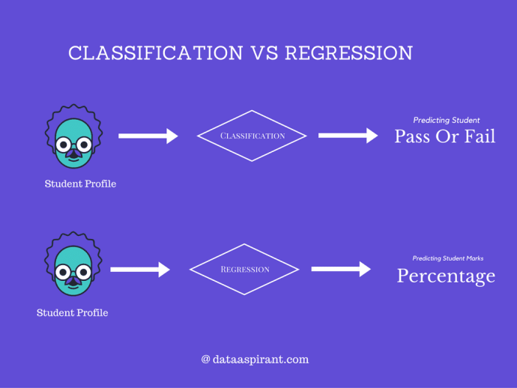

Slide 26
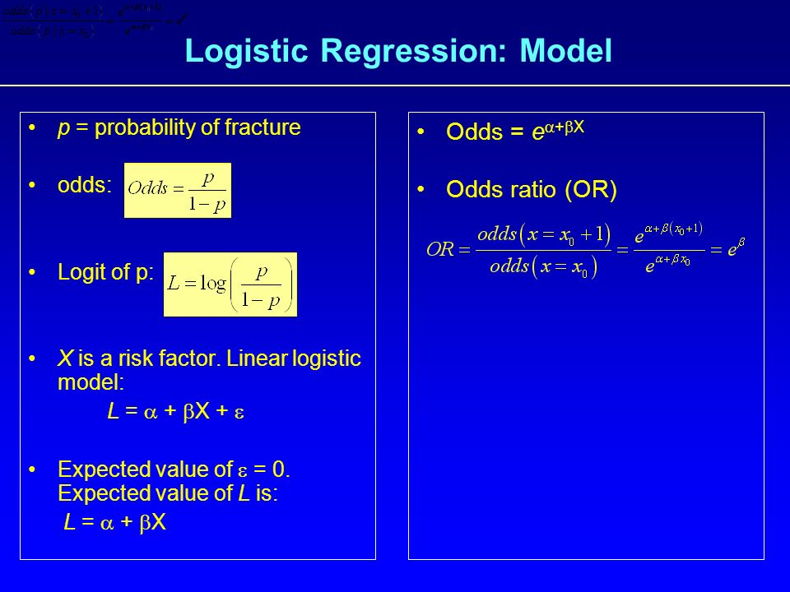

Slide 27
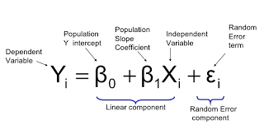

Slide 28
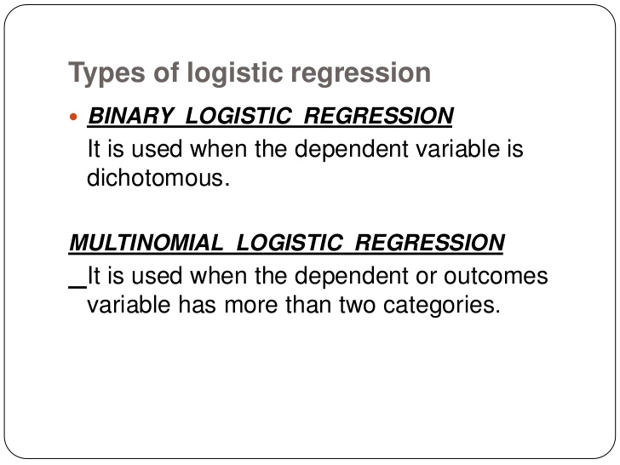

Slide 29
the probability of gender given longhair can be written as:
Pr(gender=female|longhair)

Slide 30
Ordinal Logistic Regression
Next to multinomial logistic regression, you also have ordinal logistic regression, which is another extension of binomial logistics regression. Ordinal regression is used to predict the dependent variable with ‘ordered’ multiple categories and independent variables. You already see this coming back in the name of this type of logistic regression, since "ordinal" means "order of the categories".

Slide 31
In statistics, the logistic model (or logit model) is a statistical model that is usually taken to apply to a binary dependent variable.
In regression analysis, logistic regression or logit regression is estimating the parameters of a logistic model.
More formally, a logistic model is one where the log-odds of the probability of an event is a linear combination of independent or predictor variables.
The two possible dependent variable values are often labelled as "0" and "1", which represent outcomes such as pass/fail, win/lose, alive/dead or healthy/sick.
The binary logistic regression model can be generalized to more than two levels of the
dependent variable: categorical outputs
with more than two values are modelled by multinomial logistic regression, and
if the multiple categories are ordered, by ordinal logistic regression, for example the proportional odds ordinal logistic model.

Slide 32
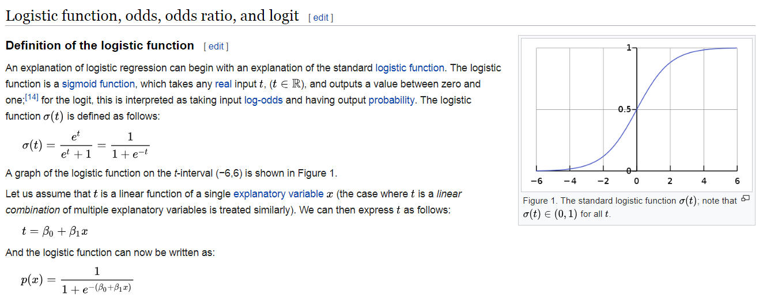

Slide 33
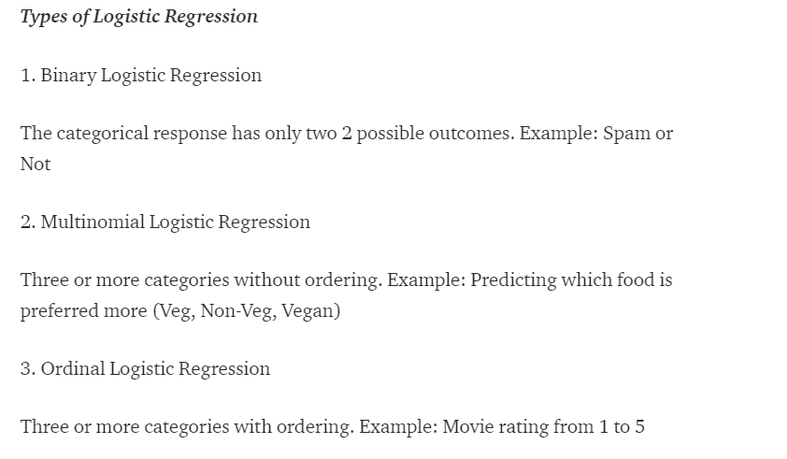

Slide 34
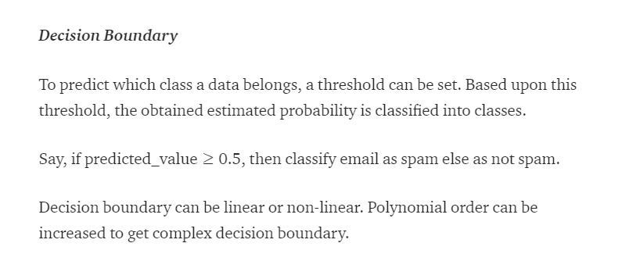

Slide 35
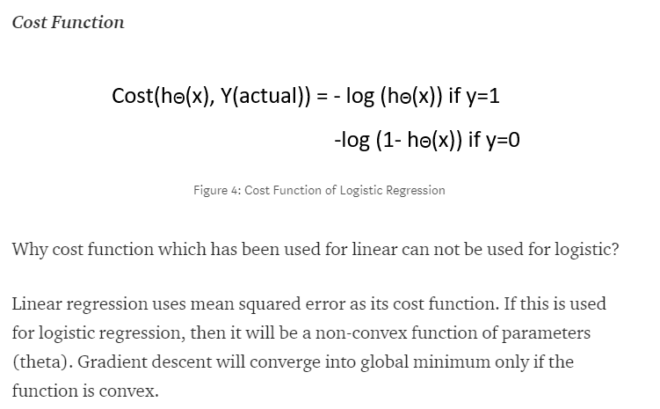

Slide 36
What Is the Difference Between Independent and Dependent Variables?
An independent variable is the variable that is changed or controlled in a scientific experiment to test the effects on the dependent variable.
A dependent variable is the variable being tested and measured in a scientific experiment.

Slide 37
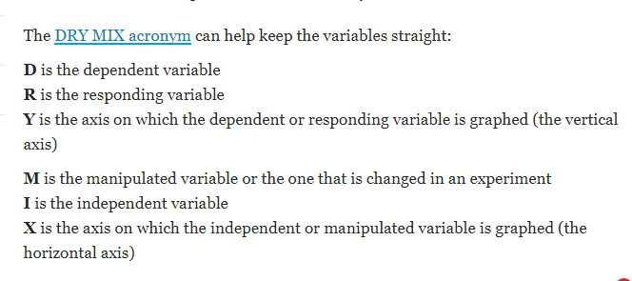

Slide 38
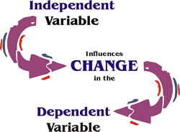

Slide 39
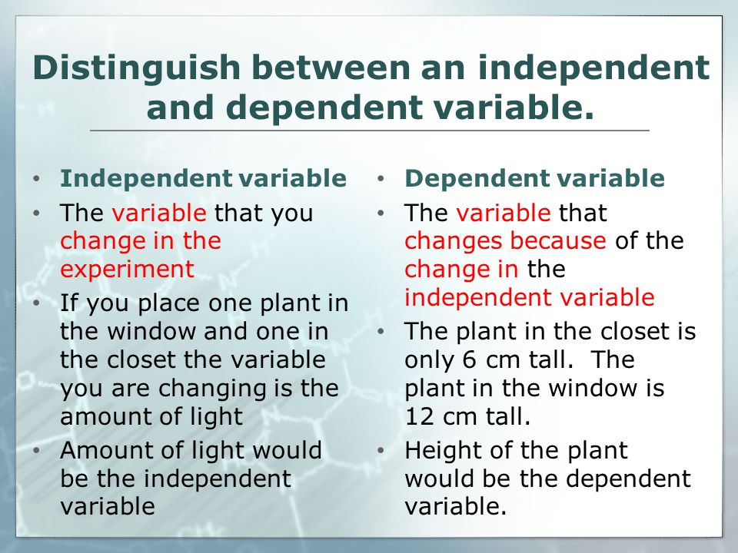

Slide 40


Slide 41
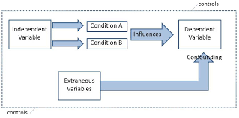

Slide 42
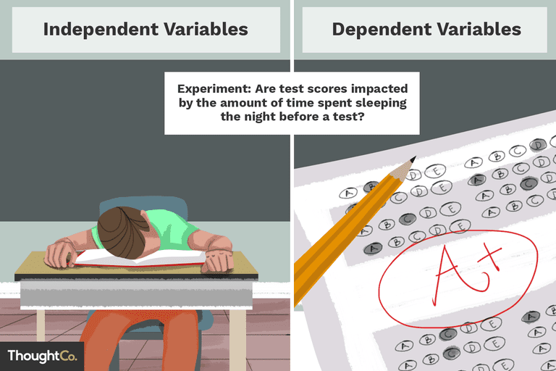

Slide 43
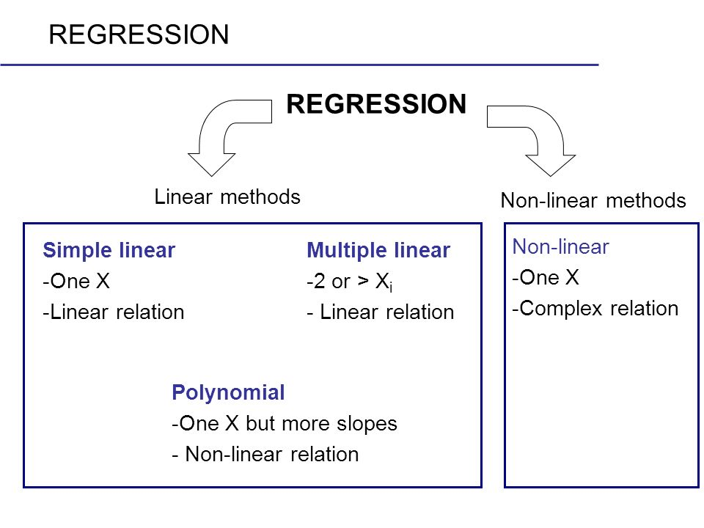

Slide 44
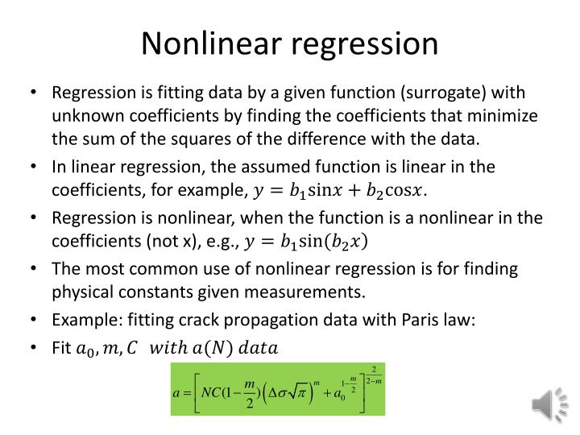

Slide 45
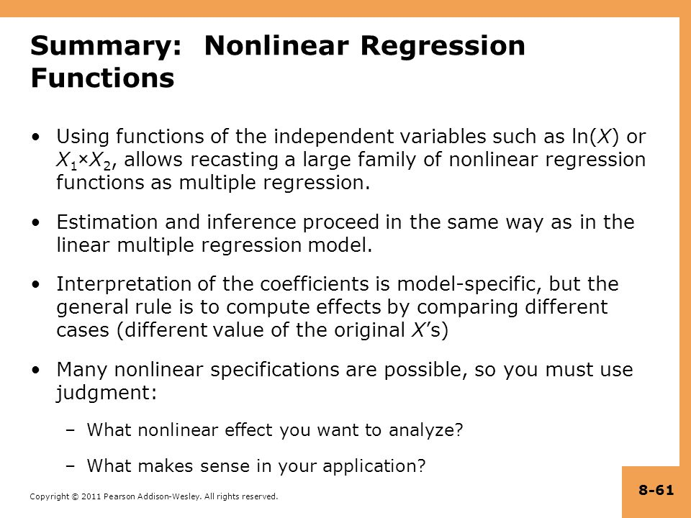

Slide 46
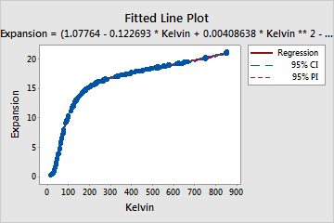

Slide 47
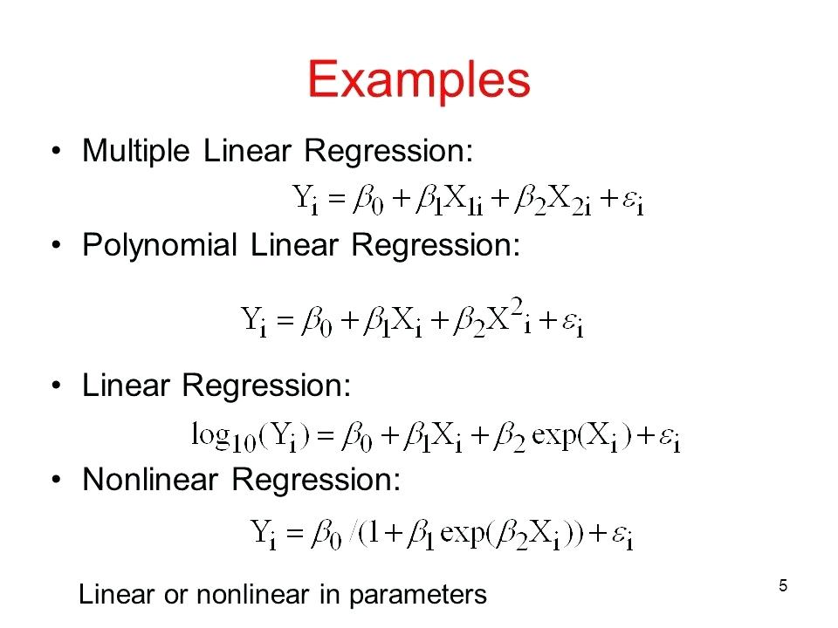

Slide 48
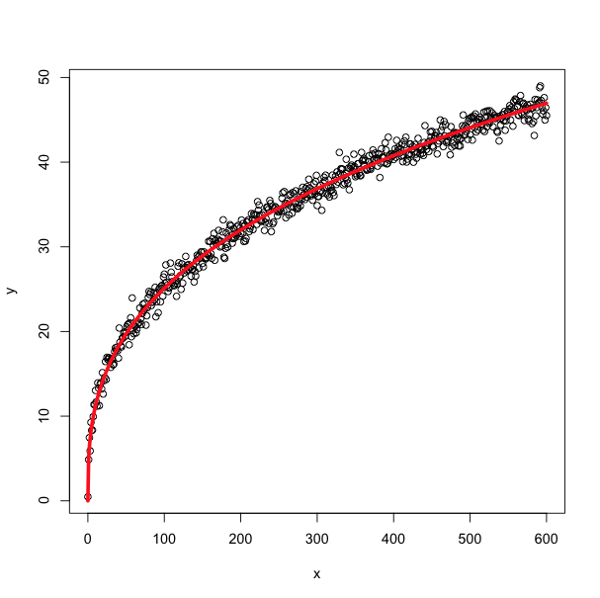
Non Linear Regression

Slide 49
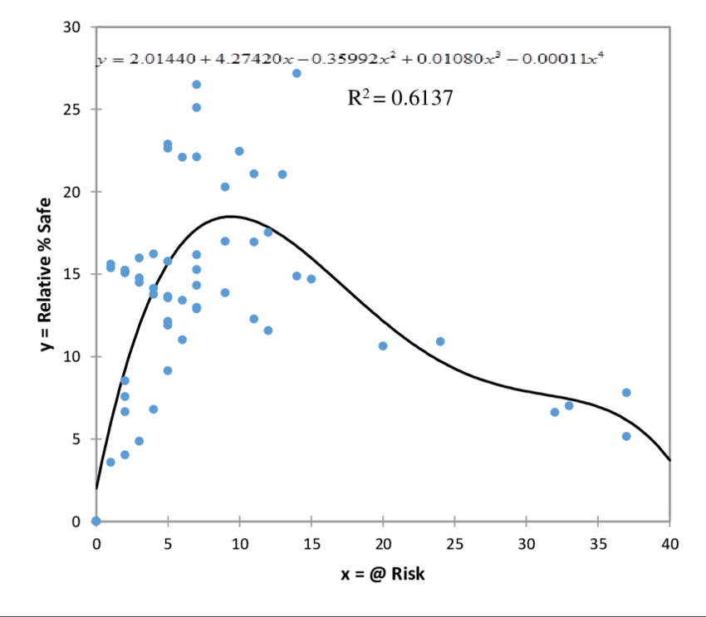
Non linear Reg

Slide 50
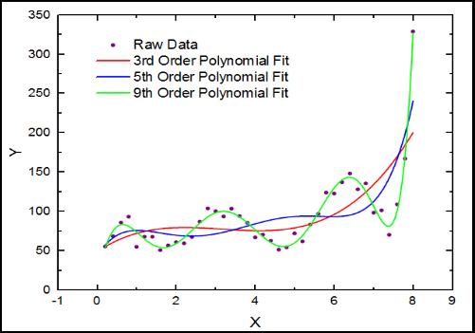
Polynomial

Slide 51
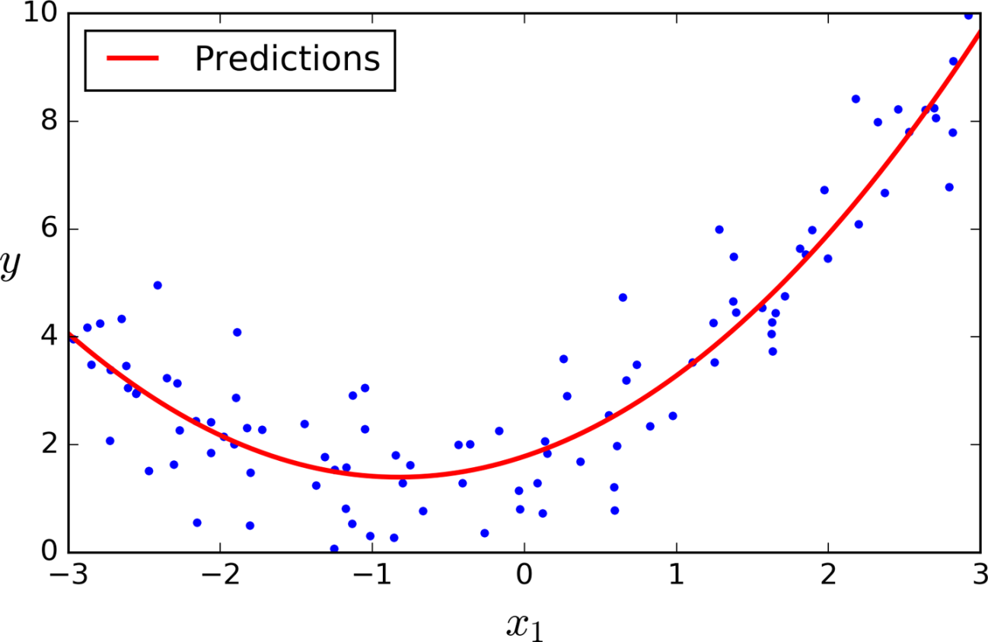

Slide 52
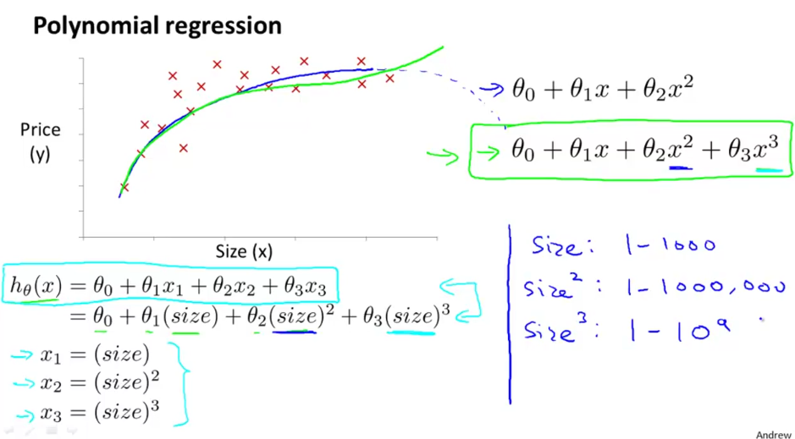

Slide 53
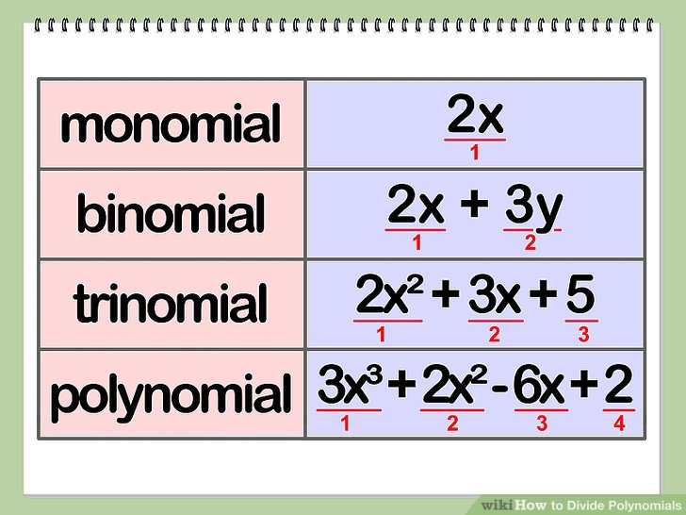

Slide 54
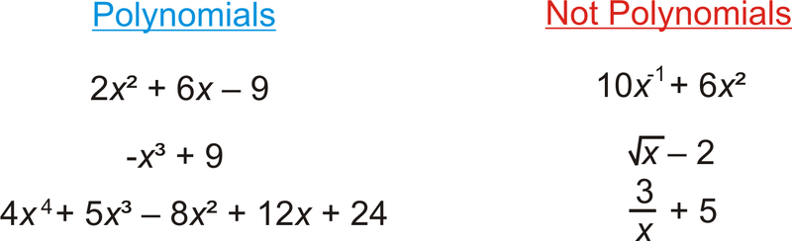

Slide 55
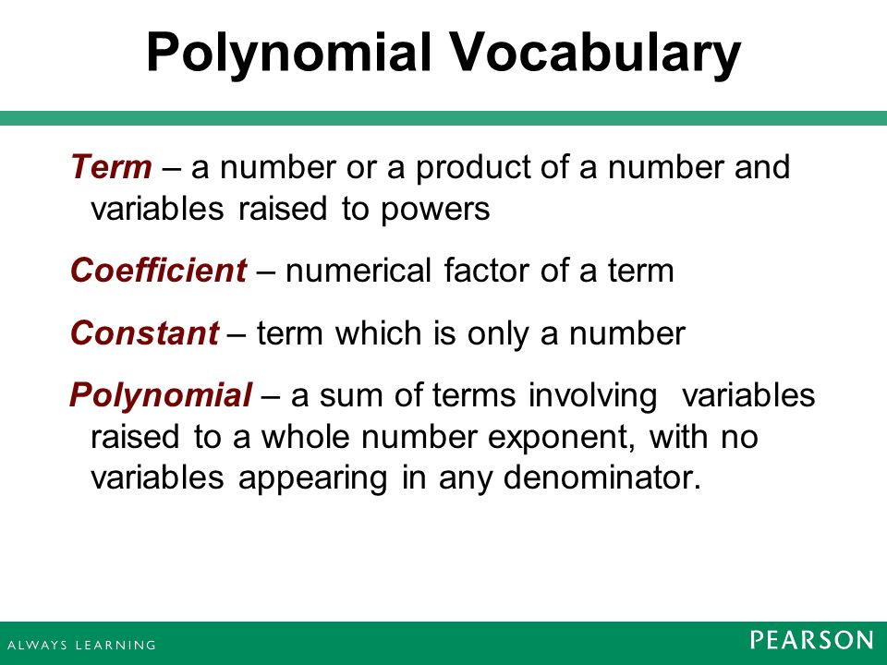

Slide 56
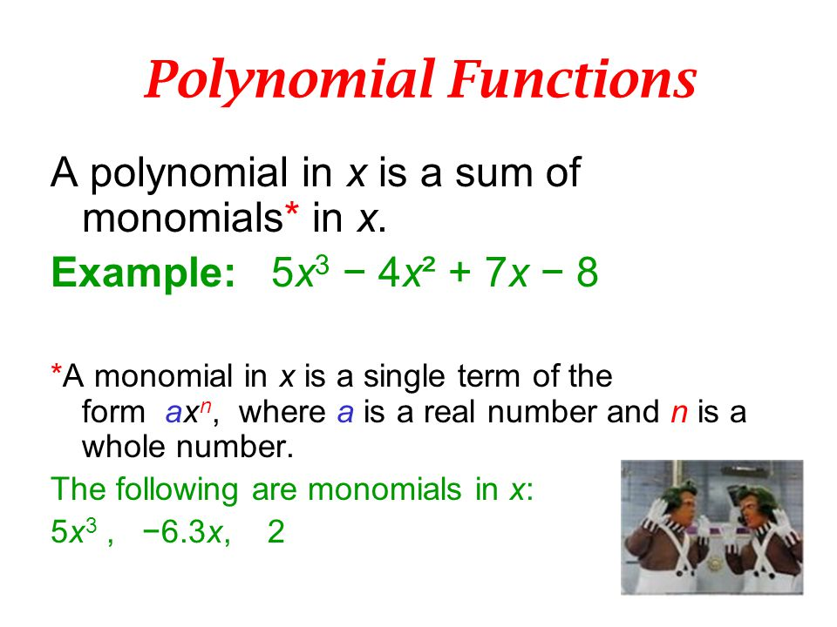

Slide 57
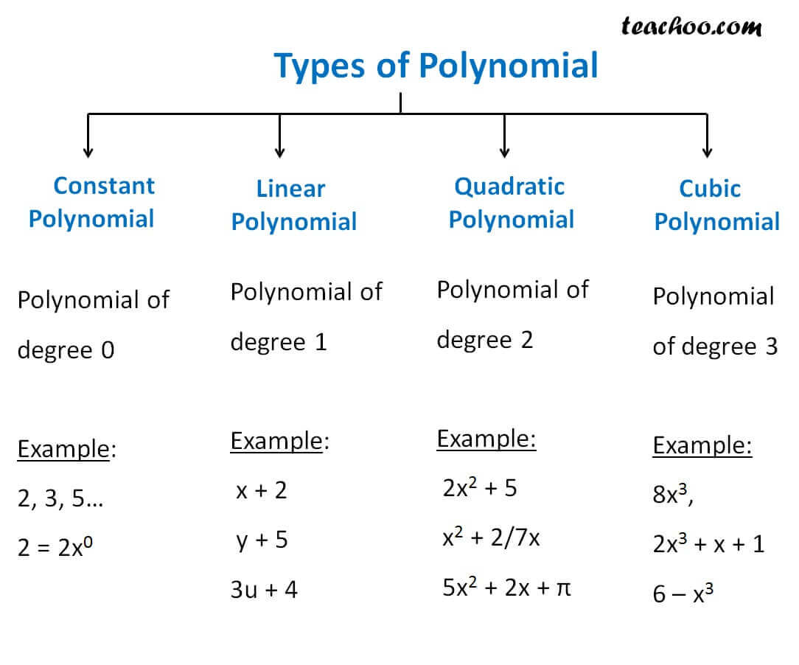

Slide 58
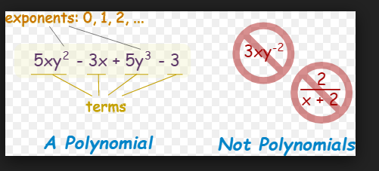

Slide 59
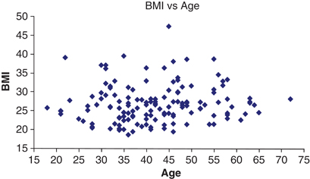
scatter

Slide 60
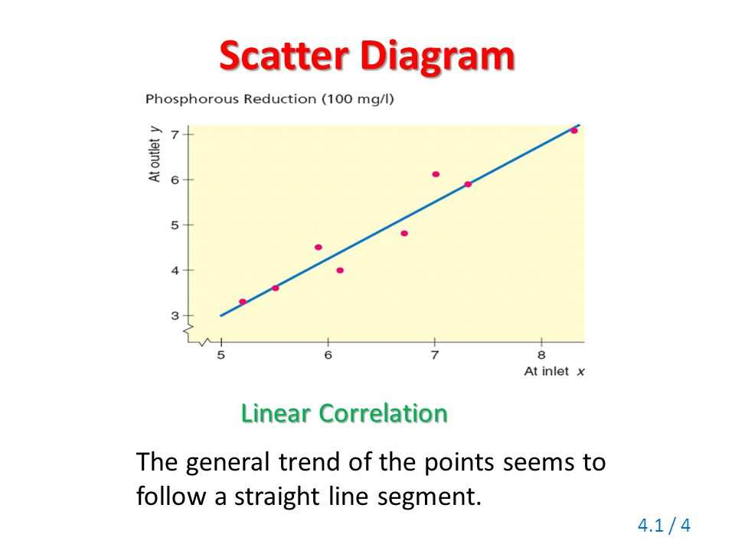

Slide 61
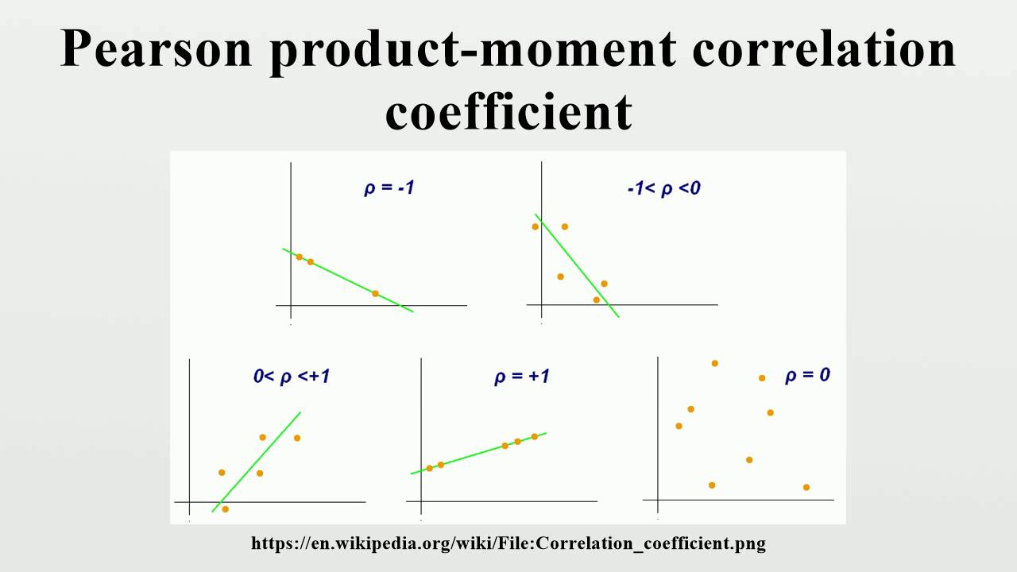
product moment correlation coefficient

Slide 62
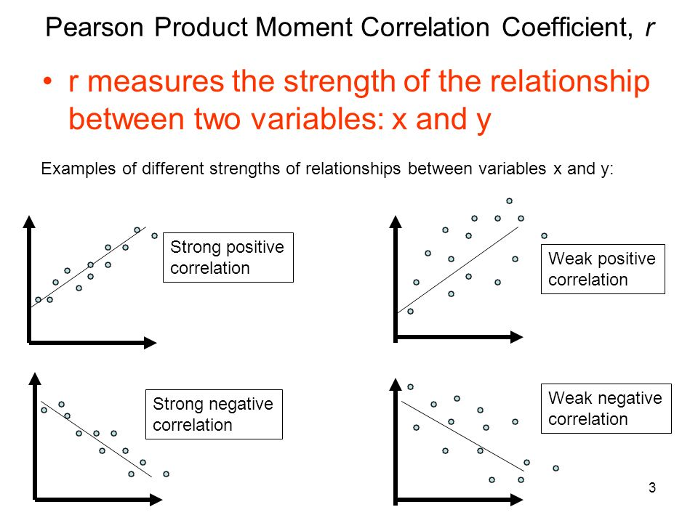

Slide 63
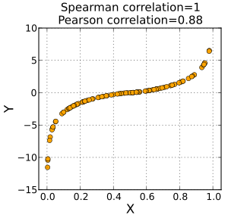

Slide 64
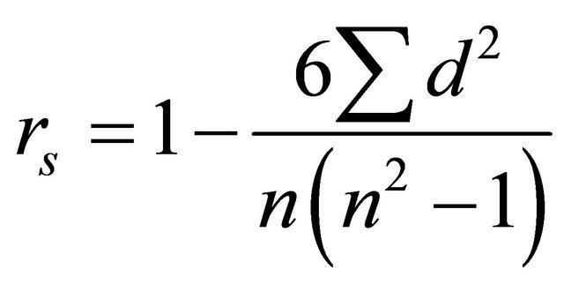
Spearman

Slide 65


Slide 66
Reg Classification
1) Linear : Simple, multiple
2)Logistic : Binary, multinomial, Ordinal, Logit, odd
3) Non-linear

Slide 67


Slide 68


Slide 69


